Slide 1
All you need to know and more
By Vie Van Noy, Director of Student Life & Special Events

Slide 2
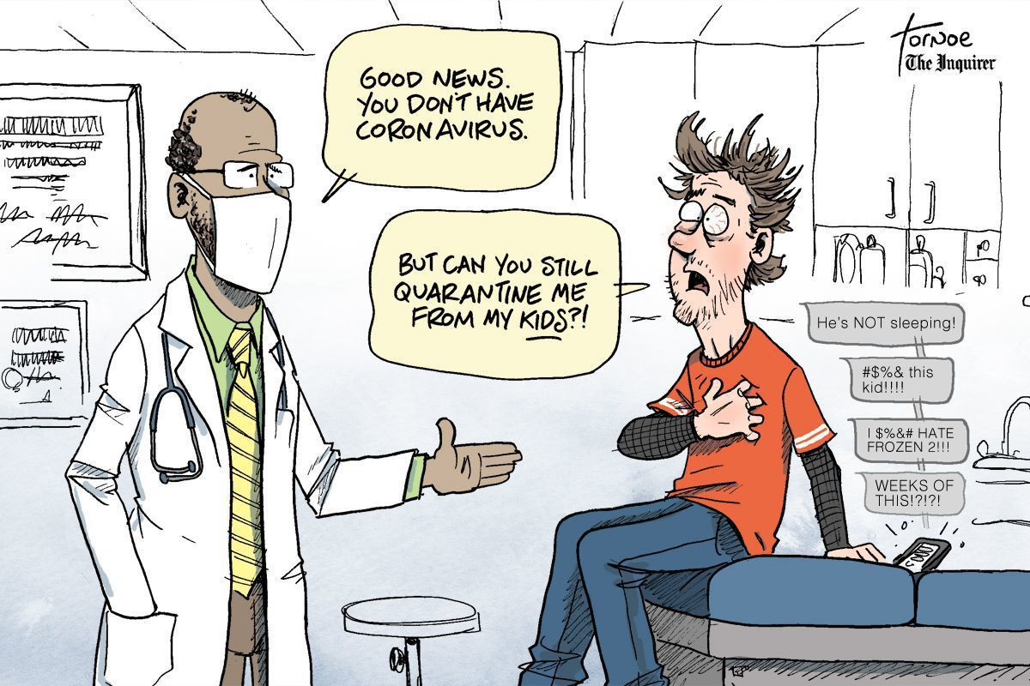
Notes:
While this is real in our circumstances now? The feeling can also seem real if you are “home alone” or feel like you are “not the priority”
So how do you survive? How do you become resilient and thrive during this medical school adventure?

Slide 3
Notes:
MAKE A PLAN – find your control in the situation. BEST PLANS require understanding and INFORMATION!
I hope to give you some valuable information and resources to assist you in creating your plan in the next few minutes.

Slide 4
Four Year Overview
Rotation Lottery (February)
Dedicated Study (6 weeks – May/June)
VSAS Application Process
(January – September)
Dedicated Study (4 weeks – May/June)
Residency Match
(3rd Monday in March – Placement that Friday)
2nd or 3rd week in May
Notes:
USMLE I & COMLEX I are P/F for the Class of 2025; COMLEX 2 PE went away.
Second USMLE one only taken if going into a heavily populated MD specialty like surgery, radiology, etc.

Slide 5
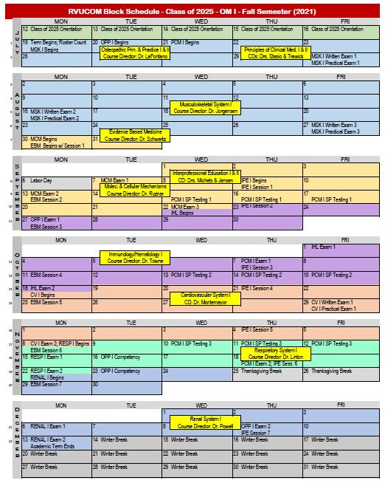
Class of 2025 Block Calendar
- Fall Semester
Free weekend?
Free weekend
Free weekend?
Not a Free weekend
White Coat Ceremony October 9th at
Tuacahn at 11:00 am
Research Week
Free weekend
Thanksgiving break!
Real Break

Slide 6
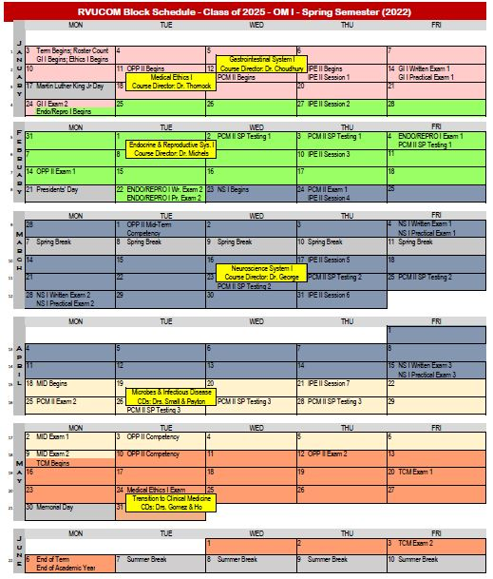
Class of 2024 Block Calendar
- Spring Semester
Free Weekend?
Free Weekend
No Break
REAL BREAK
Free Weekend
Free Weekends?
Free Weekend

Slide 7
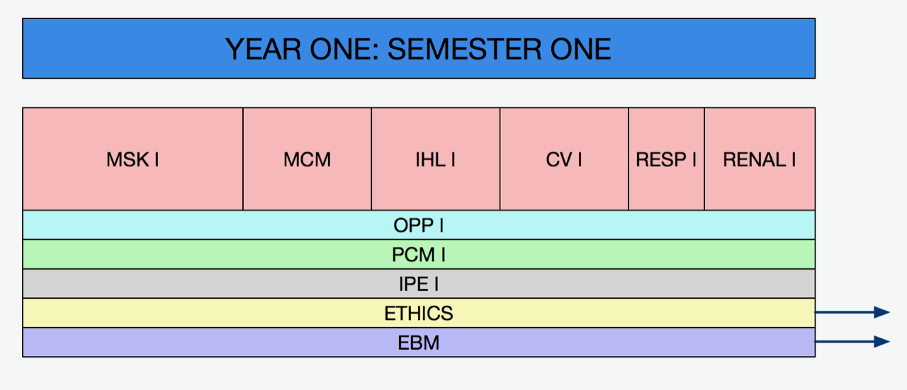

Slide 9
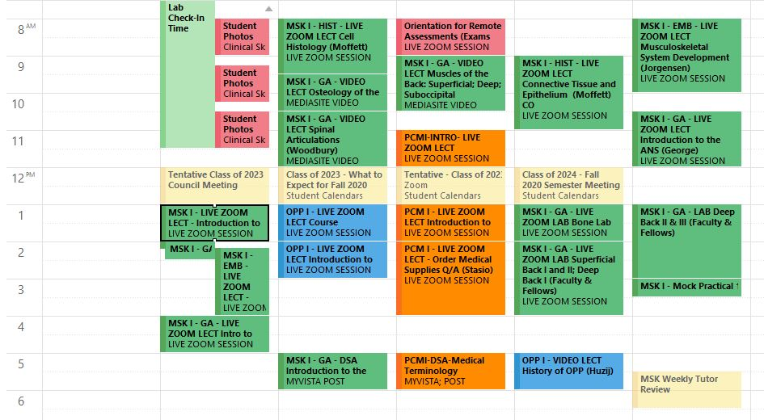
OTHER HELPFUL CALENDARS – Class of 2024 Academic Calendar
RED is important or TEST related.
Acronyms describe Course-subject matter-type of delivery
Requires STUDENT’S LOG IN for access

Slide 10
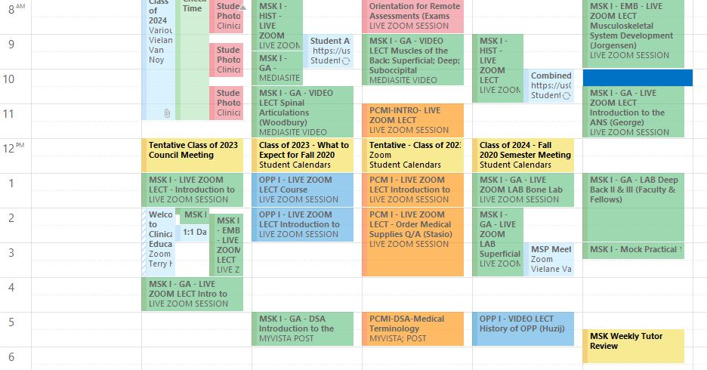
OTHER HELPFUL CALENDARS- Student Activities Calendar
Requires STUDENT’S LOG IN for access

Slide 11
Other Valuable Resources:
Academics - Educational Support Specialist (Jessica Burr), Tutors
Career Advisor – Denise El-Kassis (virtual for now)
Mental Health – Dr. Kathy Killian-Harmon, Events & Support Groups

Slide 12
Medical Spouse and Partner Group – Affiliate of RVU
Website
Newsletter
Blog
Social Media

