Slide 1
All you need to know and more
By Vie Van Noy, Director of Student Life & Special Events

Slide 2
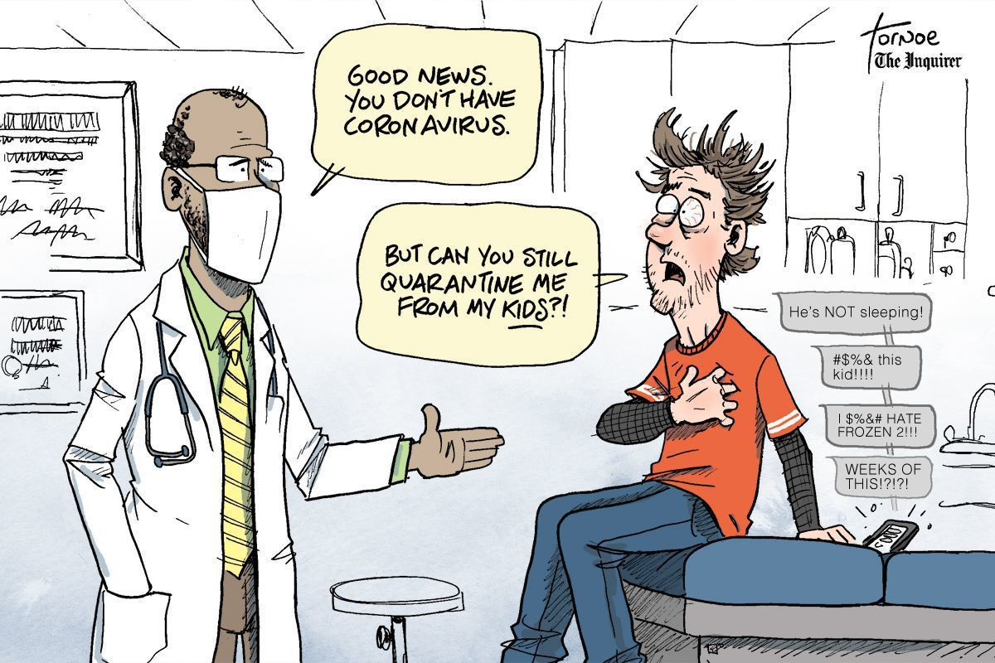
Notes:
While this is real in our circumstances now? The feeling can also seem real if you are “home alone” or feel like you are “not the priority”
So how do you survive? How do you become resilient and thrive during this medical school adventure?

Slide 3
Notes:
MAKE A PLAN – find your control in the situation. BEST PLANS require understanding and INFORMATION!
I hope to give you some valuable information and resources to assist you in creating your plan in the next few minutes.

Slide 4
Four Year Overview
Rotation Lottery (November)
Dedicated Study (6 weeks – May/June)
VSAS Application Process
(January – September)
Dedicated Study (4 weeks – May/June)
Residency Match
(3rd Monday in March – Placement that Friday)
Saturday,
May 13, 2023
Class of 2024 Graduation – Saturday, May 11, 2024
Notes:
USMLE I & COMLEX I are P/F; COMLEX 2 PE went away during COVID but was required last year as P/F here at the school; not sure this year.
Second USMLE one only taken if going into a heavily populated MD specialty like surgery, radiology, etc.

Slide 5
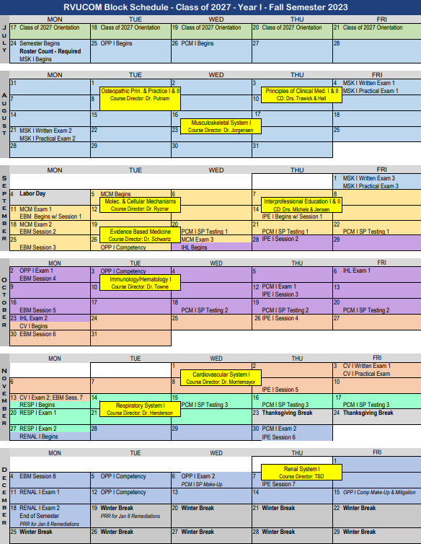
Class of 2027 Block Calendar
- Fall Semester
Free weekend?
Free weekend
NOT Free weekends – Monday Exams
Free weekend
Free weekend?
Research Week
Thanksgiving break! NOT a Free Weekend
Real Break
Notes:
Quiz on free weekend and not free weekends in October-November

Slide 6
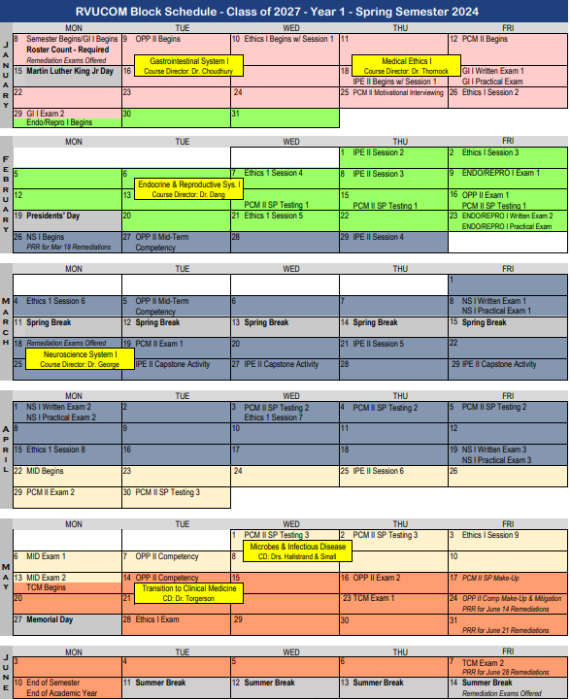
Class of 2027 Block Calendar
- Spring Semester
Free Weekend
?
Free Weekends?
REAL BREAK
Not Free Weekend – Easter
Free Weekend!
Not Free Weekend
REAL BREAK
Notes:
Practice – free weekends? Not free weekends?

Slide 7
Year 1 Courses

Slide 8
Year 2 Courses

Slide 9
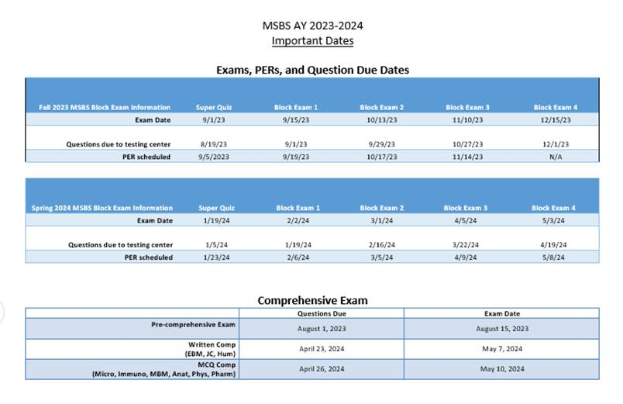
MSBS – Class of 2024 Test Schedule & Important Dates
*ACRONYMS
Graduation – Saturday,
May 11, 2024

Slide 10
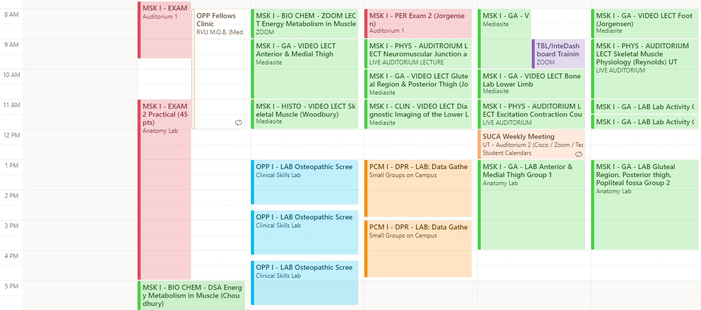
OTHER HELPFUL CALENDARS – Class of 2027 Academic Calendar
RED is important or TEST related.
Acronyms describe Course-subject matter-type of delivery
Requires STUDENT LOG IN for access
*ACRONYMS

Slide 11
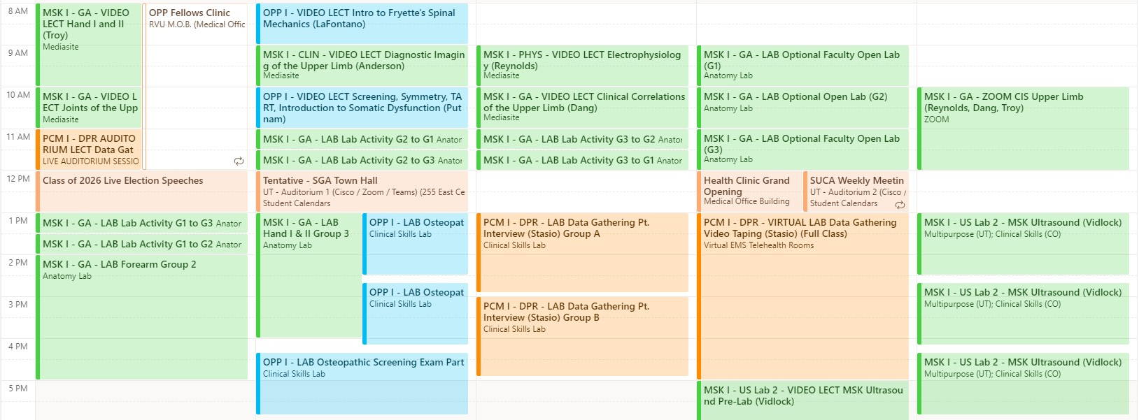
OTHER HELPFUL CALENDARS- Student Activities Calendar
Requires STUDENT LOG IN for access
*ACRONYMS

Slide 12
Other Valuable Resources:
Educational Learning Specialists & ADA - Jessica Burr & Karyn LaTurner, Tutors
Career Advising & Professional Development – Jeddie Herndon or Madison Tarleton (CO)
Mental Health – Kären Robinson, Director of Mental Health & Wellness Services (CO)
Geri Harames, UT therapist
Jamie Sceili, UT therapist
Ben Graf, CO therapist
WellConnect, 866-640-4777*
Events & Support Groups

Slide 13
Support Required!

