Slide 1


Welcome!
Orientation
2023
Notes:
Welcome: KathrAnn

Slide 2

Who We Are
Medical Spouse & Partner Group (MSP)
is composed of significant others of the
COM (medical) and MSBS (masters) students attending Rocky Vista University-Southern Utah. Together, the members of RVU-SU MSP aim
to support and serve one another, the students and the community.
Notes:
KathrAnn

Slide 3
What MSP Can Offer You!
Hey, significant others of RVU-SU students,
in both the medical and masters programs!
We are excited to have you be a part of our
community here at Rocky Vista University
in Southern Utah. As a group, we work hard to support and serve one another, the students,
and our community.
Notes:
KathrAnn

Slide 4
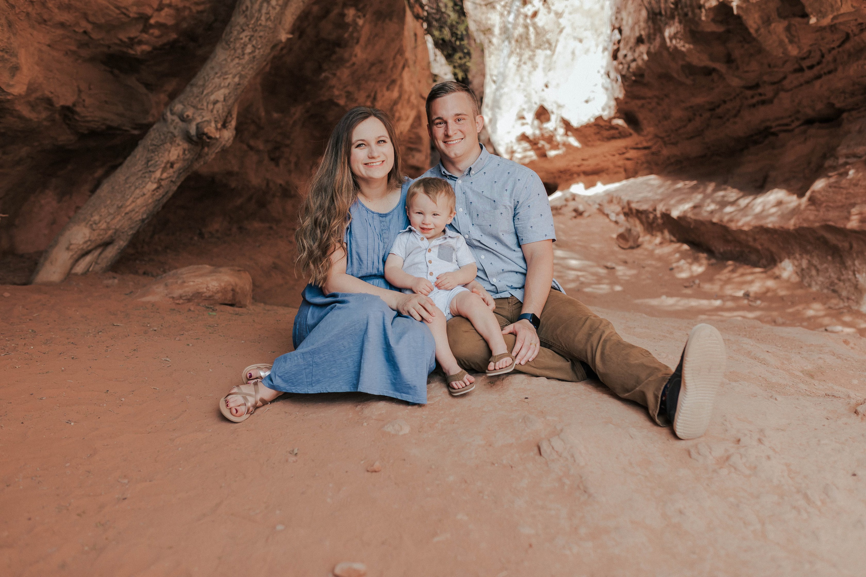
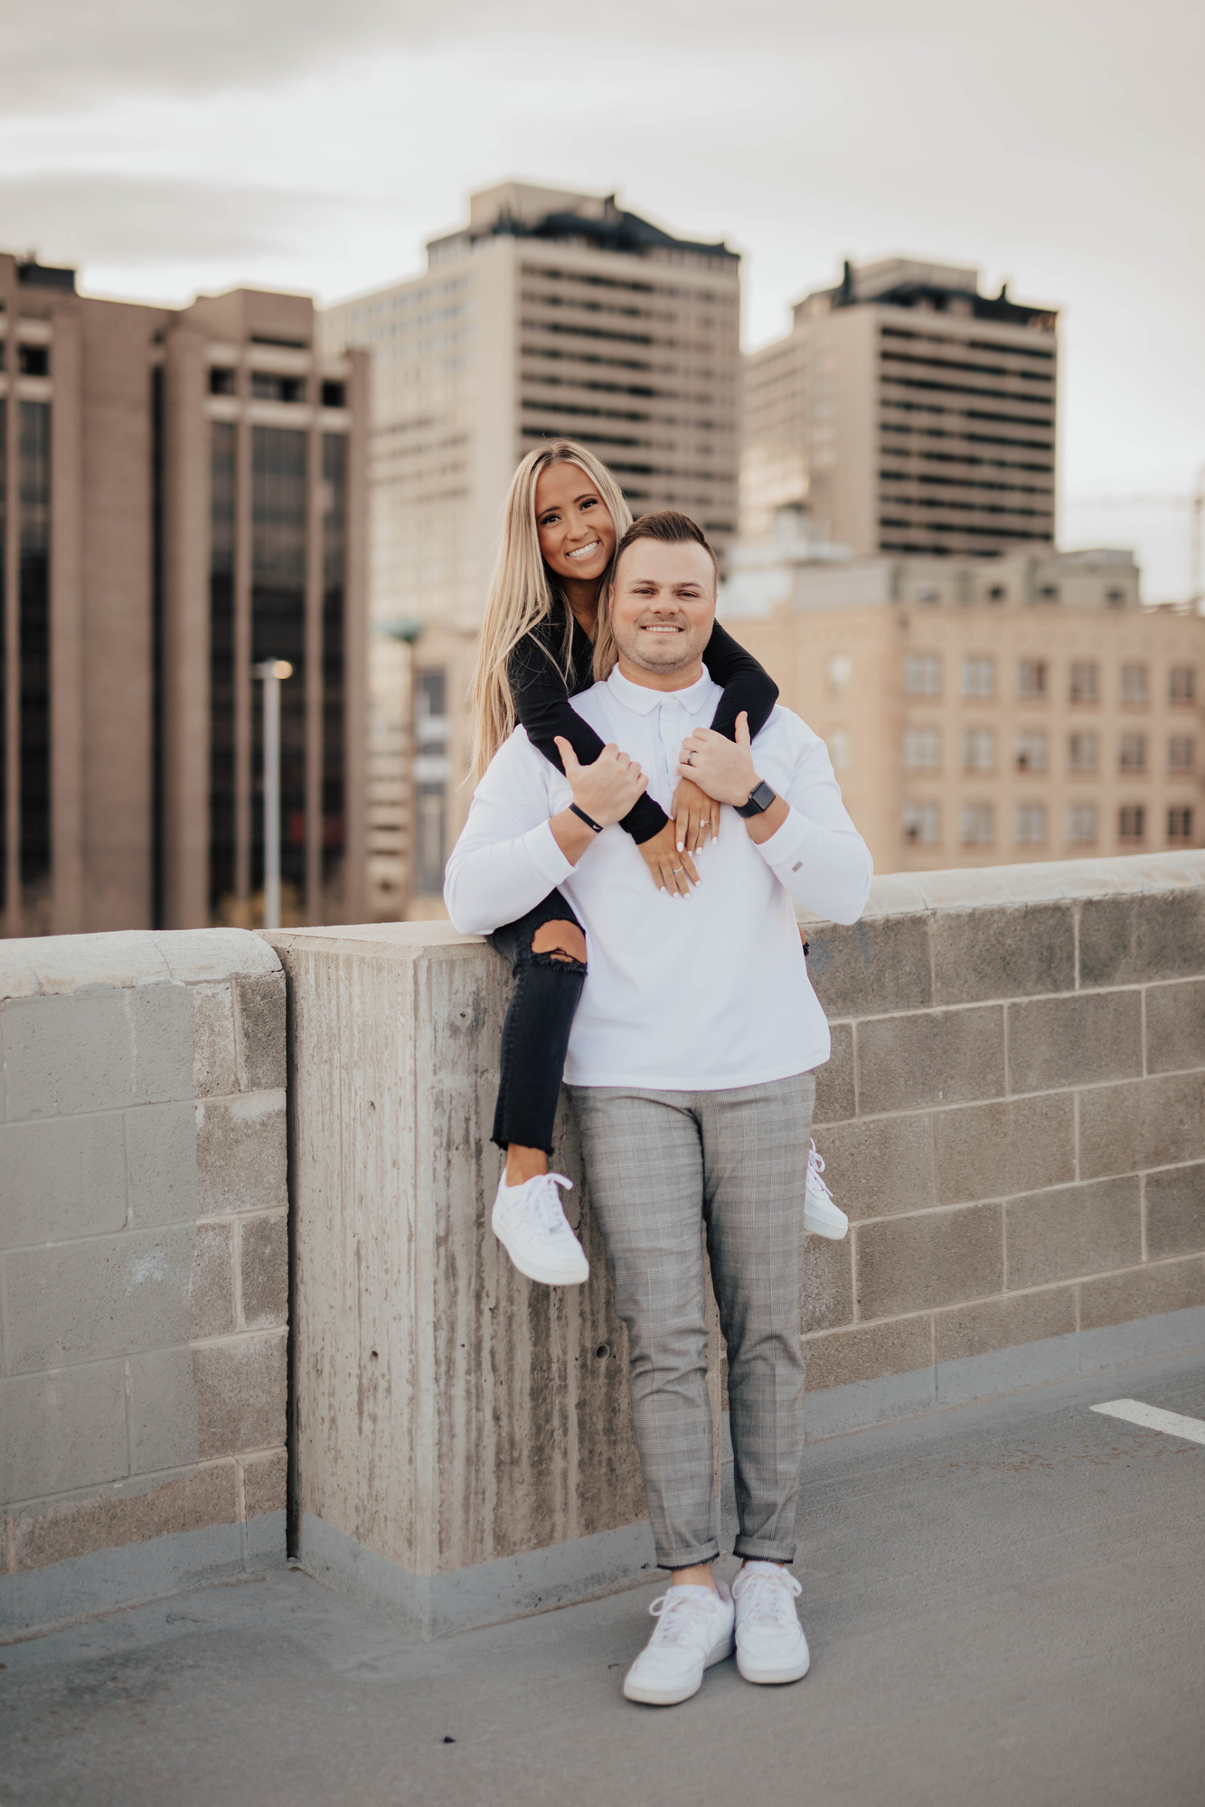
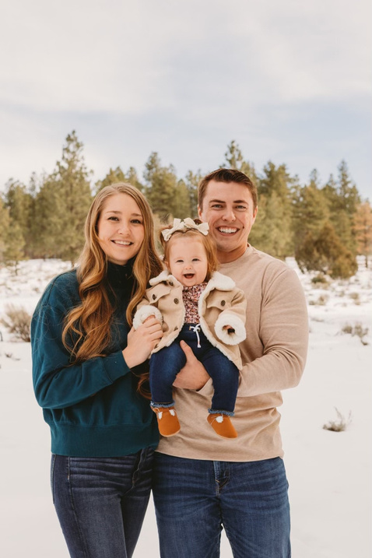
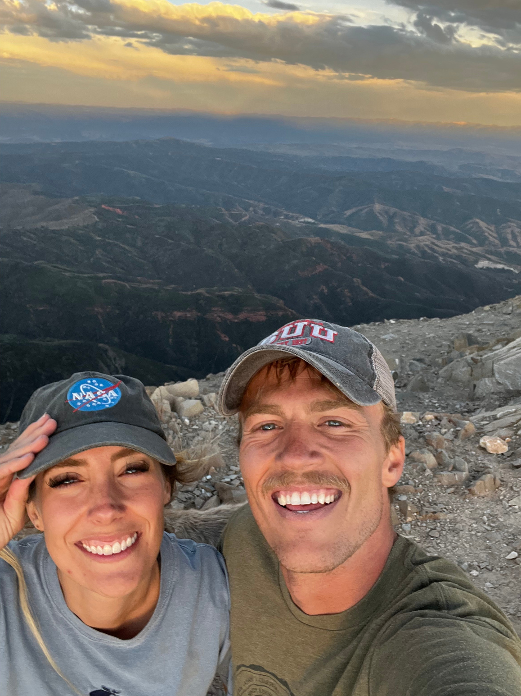
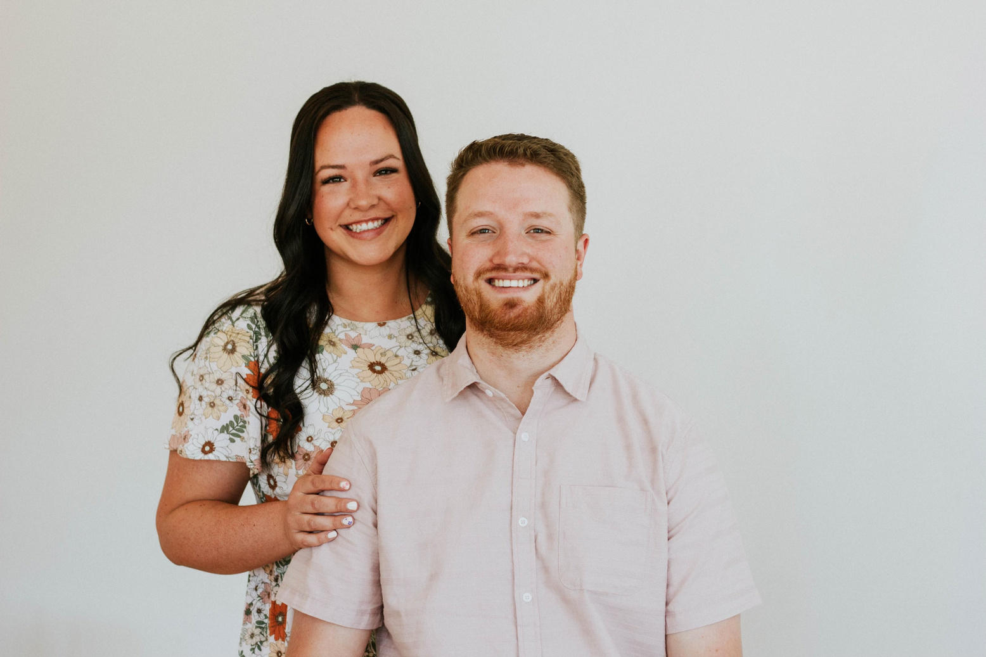
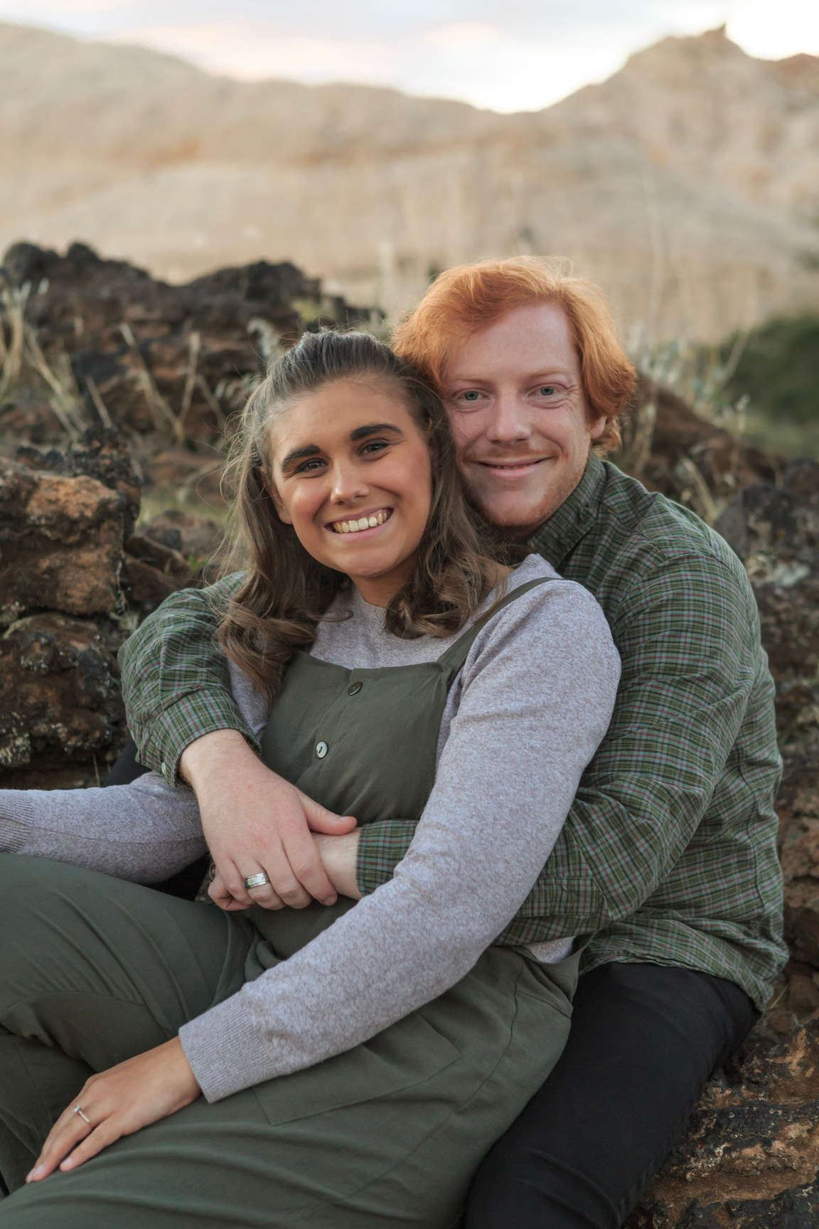
MSP 2022-2023
Presidency
Savannah Blomquist
Isabella Collins
Taylor Steed
President
Vice President
Secretary
Whitney Robins
Allison Abraham
Callie King-Stevens
Activities Chair
Treasurer
Social Media Coordinator
Notes:
KathrAnn: Take some time to introduce you to each of our MSP Presidency members

Slide 5
President
Savannah Blomquist
  Works full time in marketing and research for an events company
  Husband, Jayce is a 2nd year
  Son Liam is turning 2 soon
  Two dogs: Jax and Mila husky mixes
  Moral, liaison to school, overseer of Presidency/Activities & help where needed
  From Montana
  Loves hiking, camping, boating, basically anything outside
  Passionate about making MSP a helpful community for all of the significant others at RVU.
Notes:
KathrAnn Introduce self

Slide 6
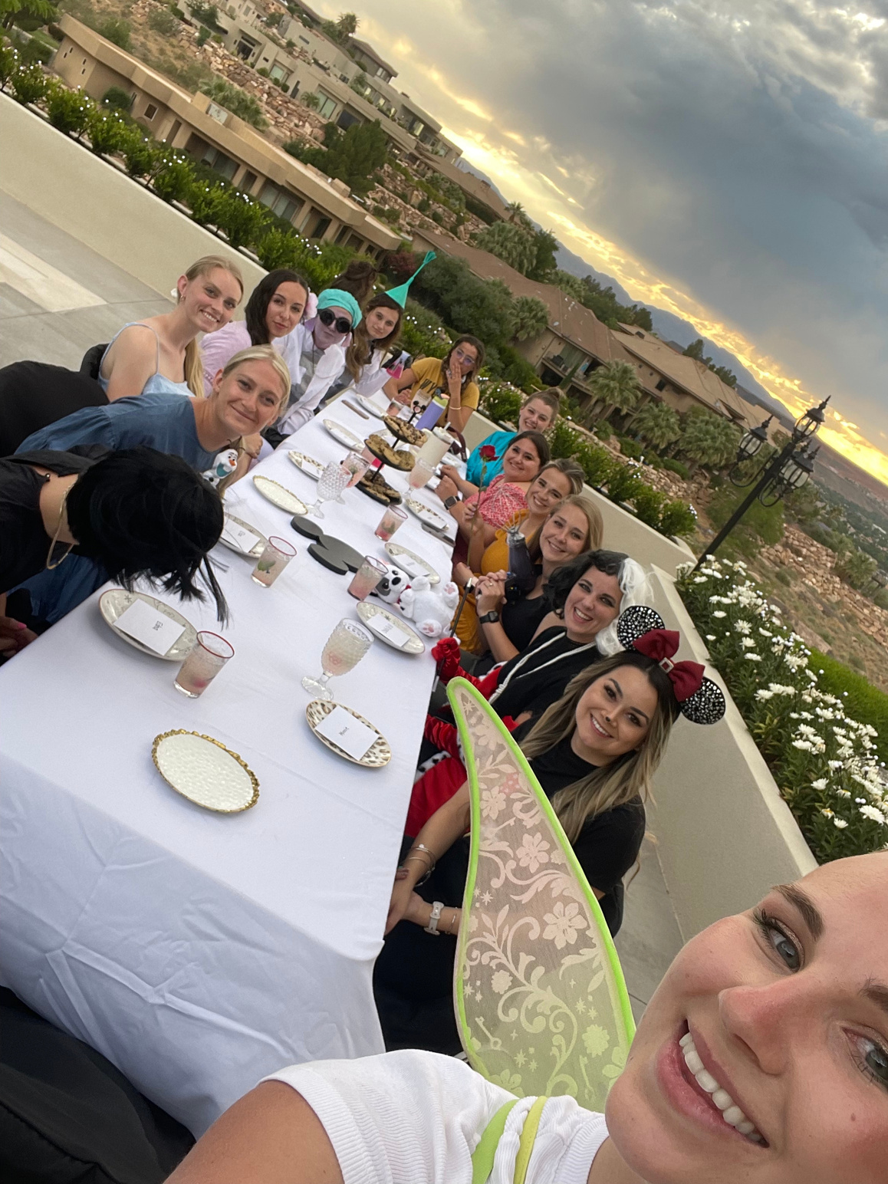
Why Be Involved in MSP
  Making friends
  Keeping busy
  Finding support
  Acclimating to St. George
  Better support your student
Notes:
KathrAnn Introduce self

Slide 7
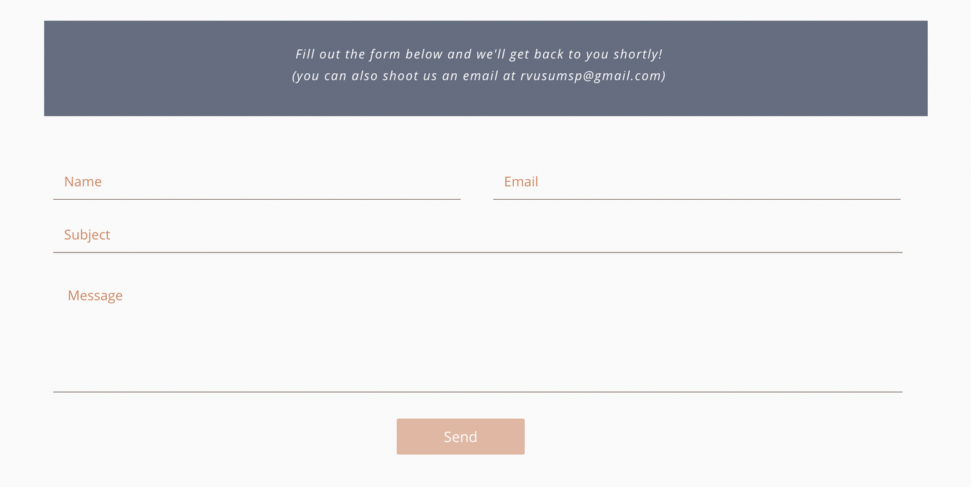
Morale
We are here to help and support one another! If you or someone you know in the RVU community could use some extra celebration or need a little extra love, this is one way we can provide support.
https://www.supportingmyfuturedo.com/morale
Notes:
KathrAnn Introduce self

Slide 8
Vice President
Isabella Collins
  Husband Myles is in his 2nd year and in the air force
  Has cute Maltese yorkie named Winston.
  Pregnant with first baby
  Fundraising, Winterfest, assist President/help where needed
  Loves reading, shopping, traveling, camping, hiking, hosting parties, and hanging out with our friends.
  Excited to get to know all of you and make fun memories together during this crazy medical school journey!
Notes:
Mariana introduce self

Slide 9
Join Groups & Clubs!
  Park Day
  Book Club
  Game Night/Bunco
  Craft Club
  Breakfast Club
  Bach Babes
  Yardsale Group
  Virtual Book Club
Get Involved!
Notes:
Just a few pictures of some of the groups.

Slide 10
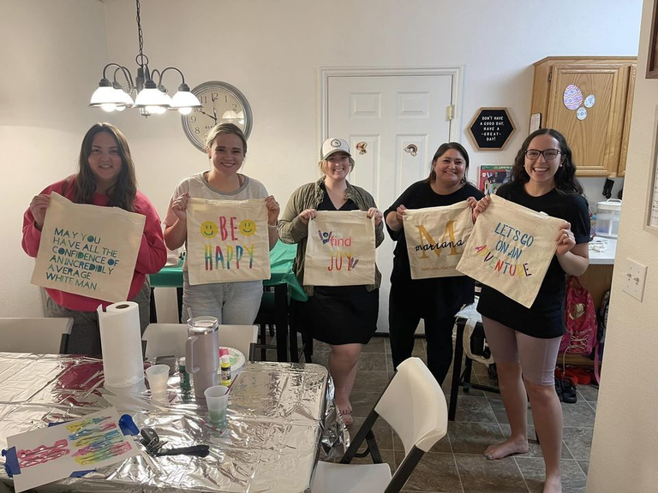
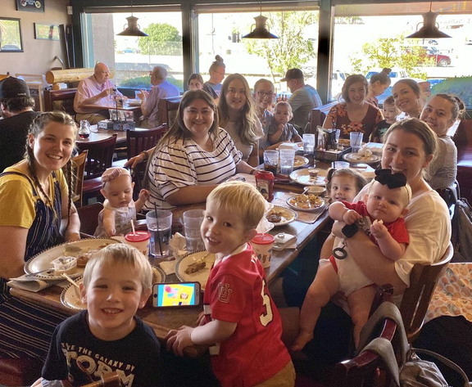
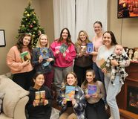
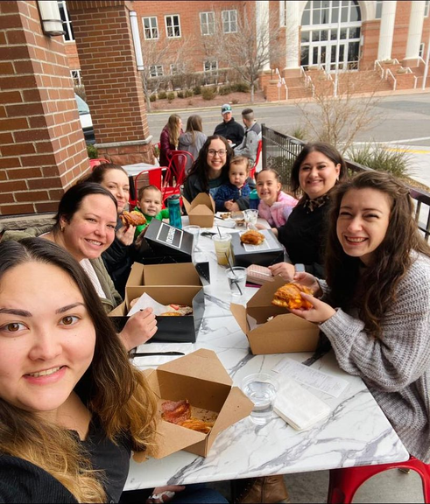
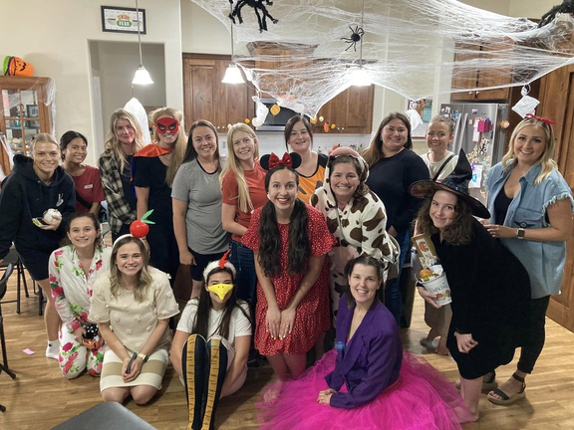
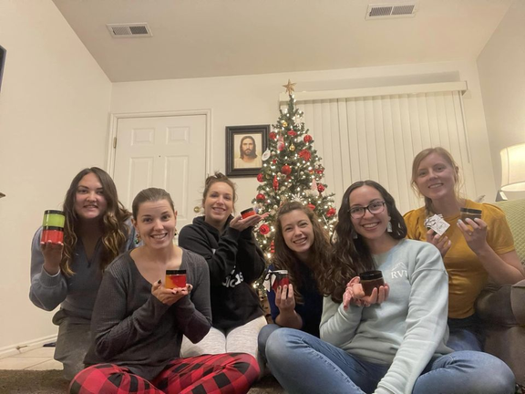
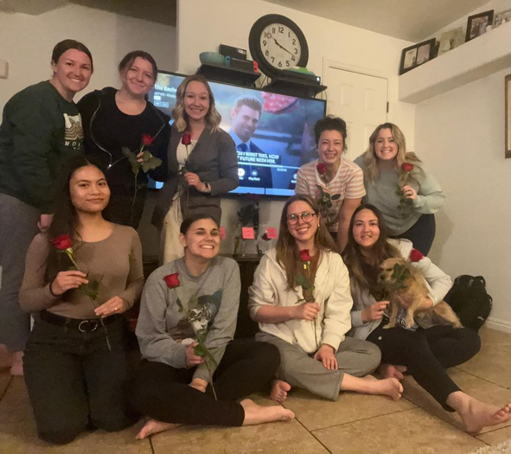
Join Groups & Clubs!
Get Involved!
Notes:
Just a few pictures of some of the groups.

Slide 11
Get Involved!
supportingmyfuturedo.com/groups-and-clubs
Notes:
Go over the groups you can join

Slide 12
Treasurer
Allison Abraham
  Husband Chris is in his 1st year
  Has the cutest mini golden-doodle named Jack
  Oversees budget & bookkeeping, help execute fundraising & support Activities Chair
  Works remotely as a property management account
  Enjoys hiking, playing pickleball, crafting, baking, playing games, and reading.
  I can’t wait to get to know you and make new memories through med school!
Notes:
Larissa introduce self

Slide 13
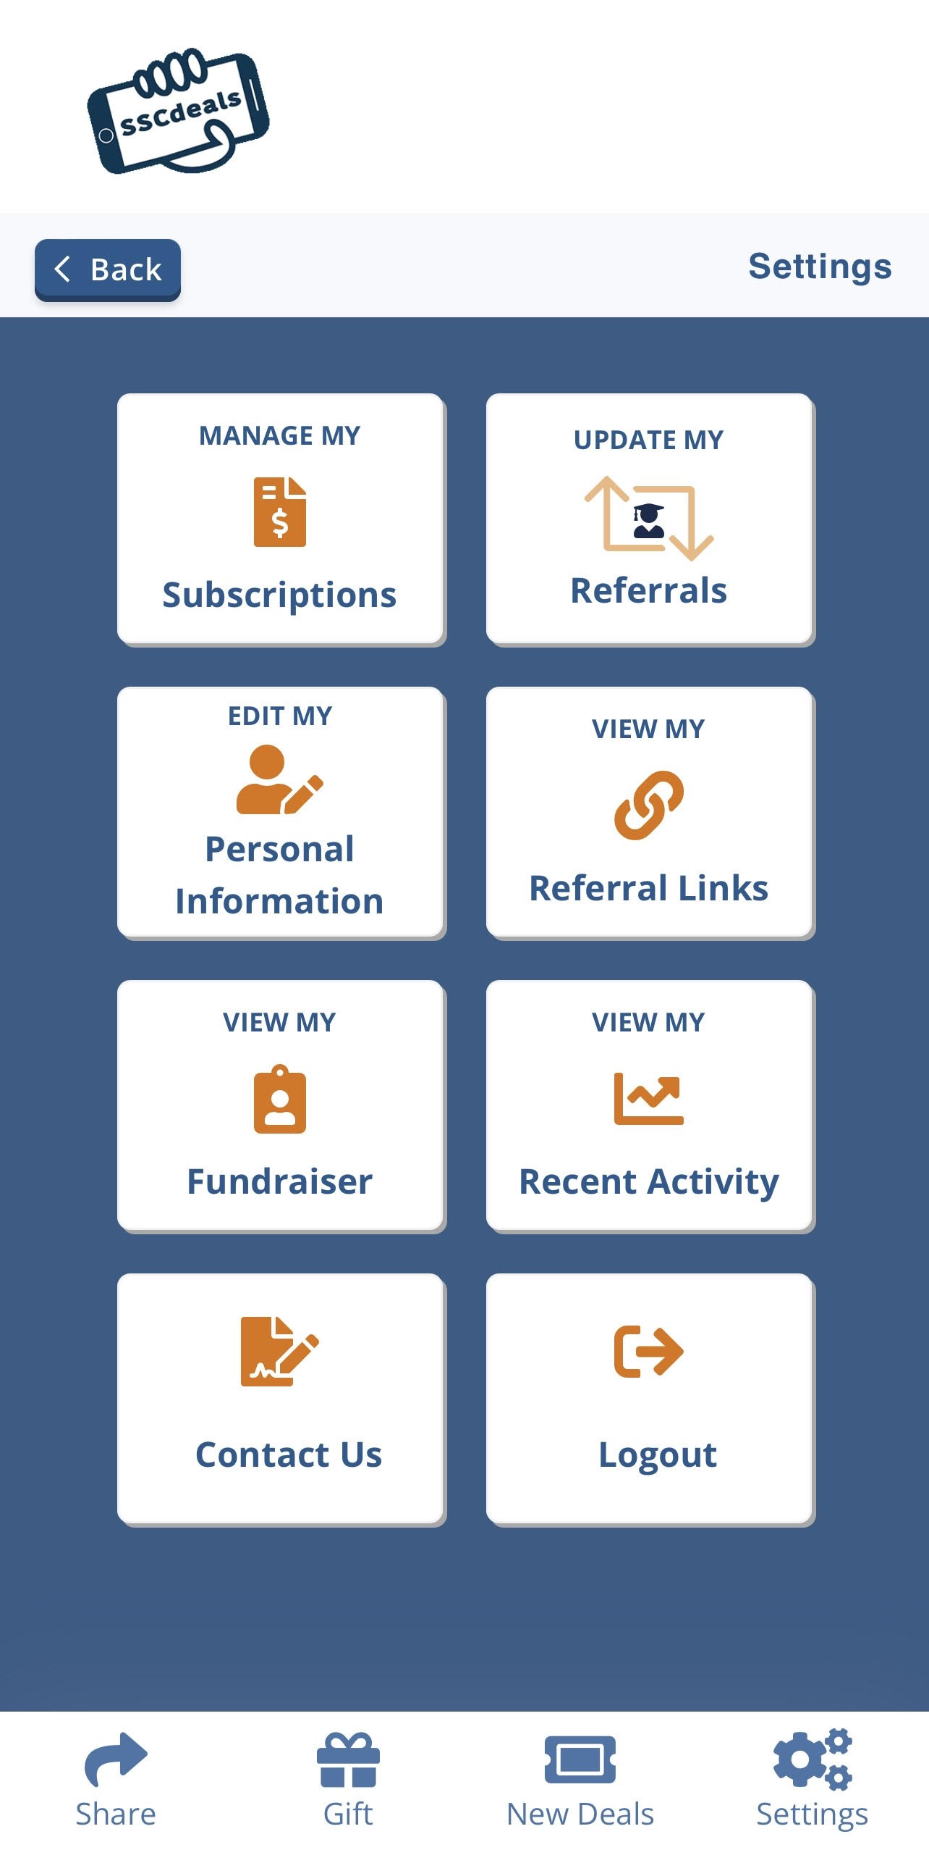
Starving Student Card Fundraiser!
Support us here

Slide 14
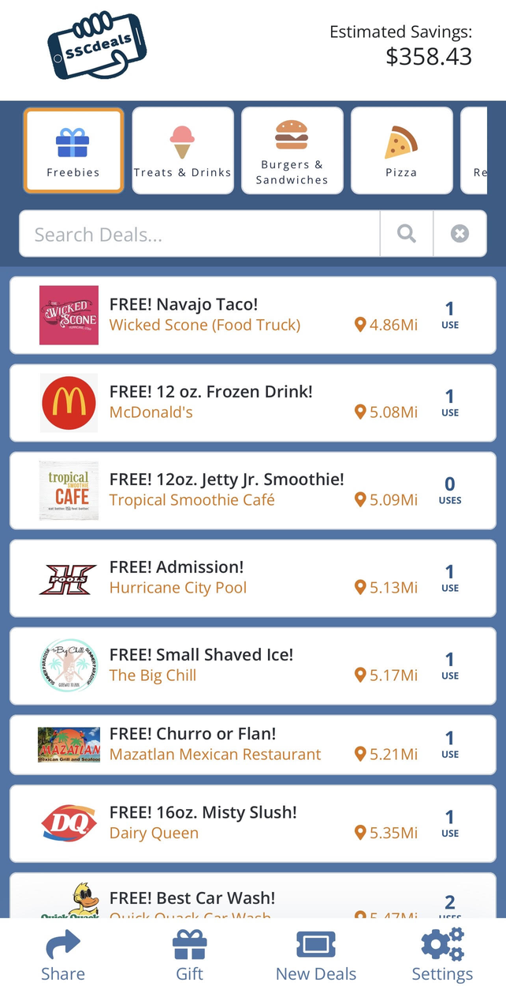
Use the card to save a ton of money on restaurants, entertainment, and even car washes and repairs!

Slide 15
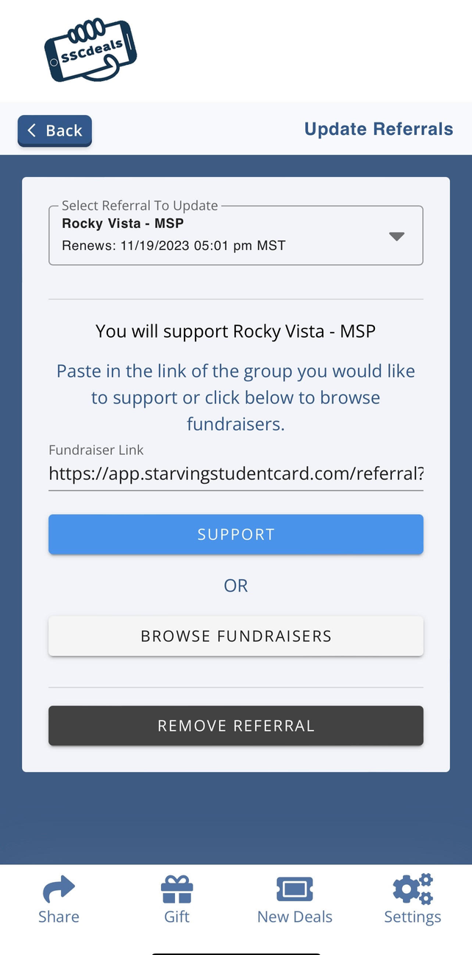

If you already have a card update the referrals to support MSP

Slide 16
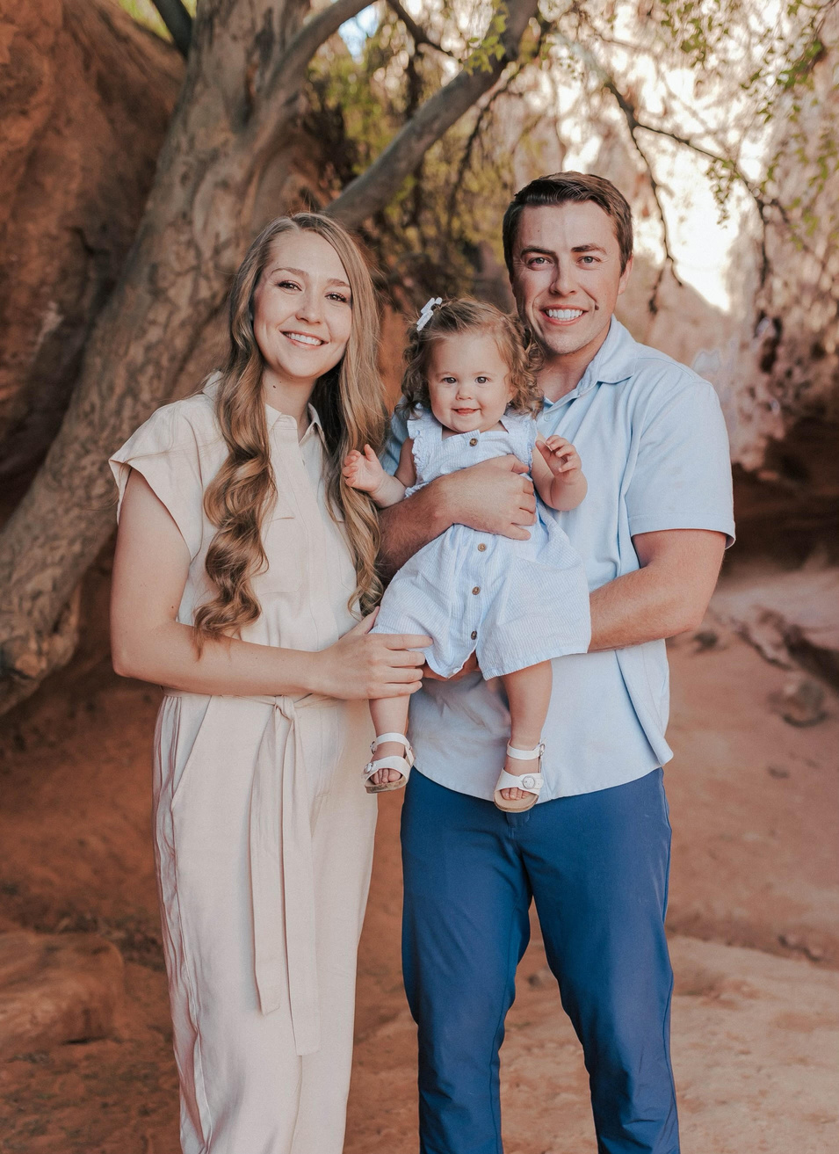
Secretary
Taylor Steed
  Husband Logan is in his 2nd year
  Daughter Addilyn is one
  Organize & create presidency agendas, meetings notes, create signups/surveys, submit approval forms & help organize yearly elections
  Graduated from SUU with my bachelors in Elementary Education
  Loves playing sports, baking, being a mom, and spending time with family.
  Looks forward to getting to know all of you and enjoying all the activities and memories that we will make together this coming year!
Notes:
Heidi introduce self

Slide 17

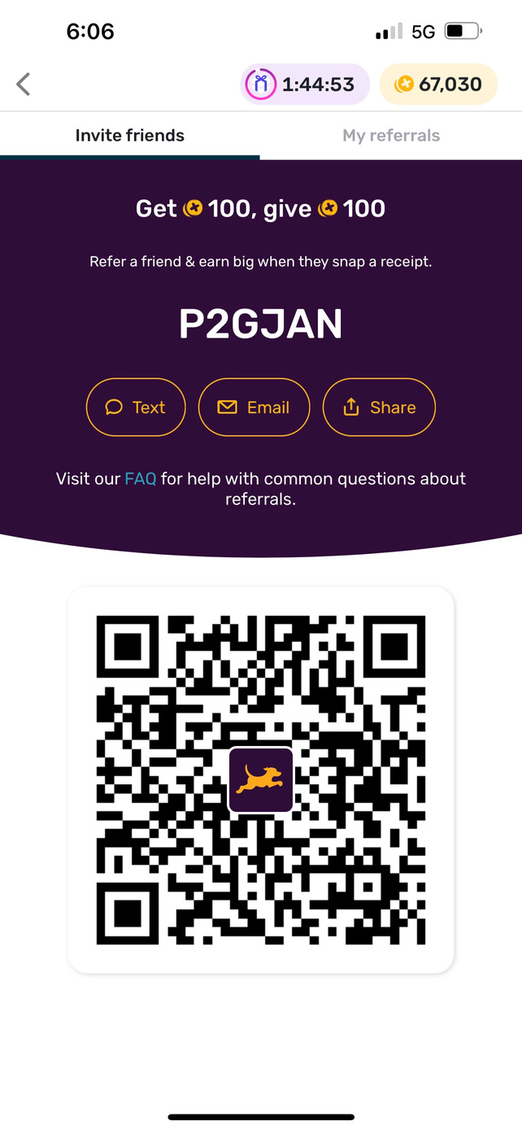
Fetch App
  Scan receipts and earn money for gift cards
Notes:
Heidi introduce self

Slide 18

Indy Clover
  Pay $30 for a booth where you can sell clothes or other things and make a good amount of money
  Book a booth here

Slide 19
Activities Chair
Whitney Robins
  Husband Cameron is in his 2nd year
  Plan, implement and execute activities, assist with incoming members & run activity meetings
  Loves hiking/canyoneering/rock climbing
  Graduated from UVU in hospitality management with a minor in event planning
  Excited to plan fun activities for you all and get to know you all!
Notes:
Helen introduce self

Slide 20
Activities
Notes:
Helen comes on stage

Slide 21
Upcoming Events
Ice Cream Social
Favorite Things
Resource Night
August 1, 2023
7 PM
RVU Campus
-Come enjoy a sweet treat and get to know other significant others!
August 16, 2023
7 PM
Ivins Unity Park
Main St & 100 North Ivins
-Bring THREE (of the same) favorite things (no more than $5 each) and leave with
three new favorite things!
TBA
Zoom
-Come learn about tips
and tricks to save money
during your Significant Others masters and medical school
journey. You will learn about
health insurance, federal aid
(WIC, Food Stamps, etc)
as well as ways to save money
on things to do in the
Saint George area!
Notes:
Helen explains upcoming activities.
The resource night mention it goes with the insert in their brochure.

Slide 22
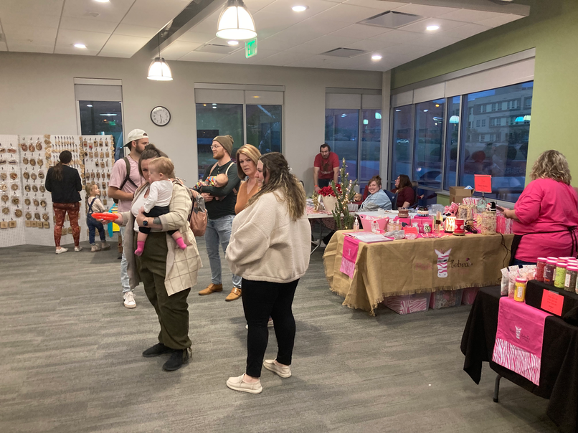
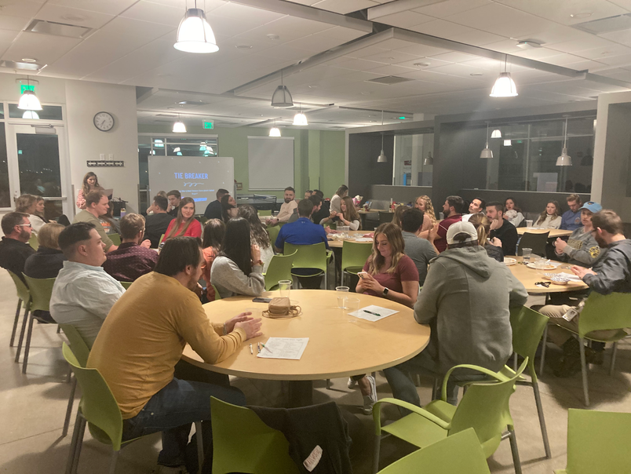
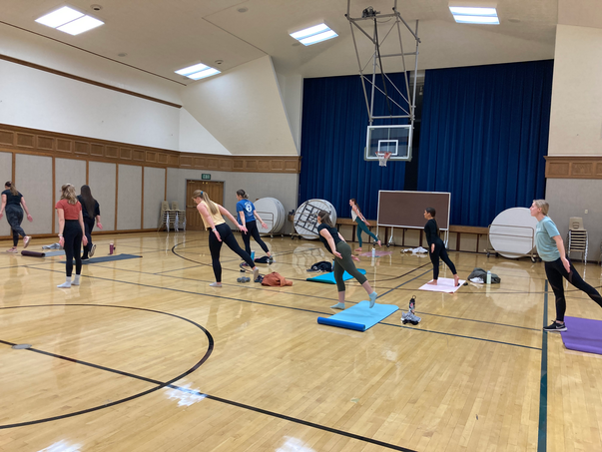
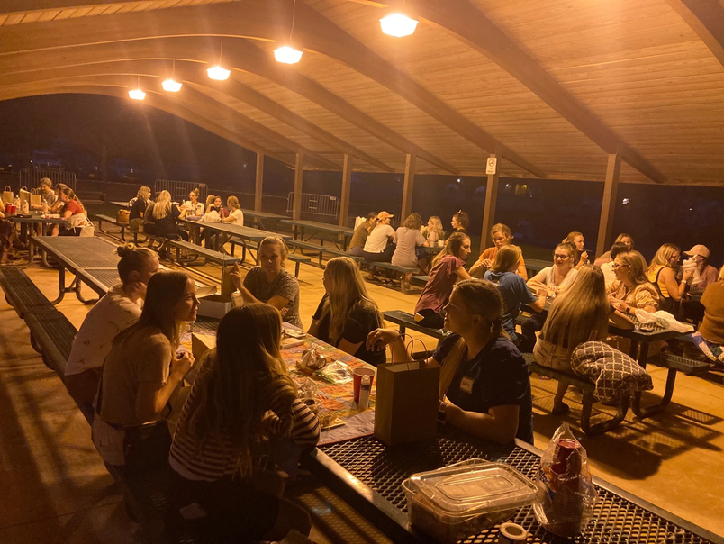
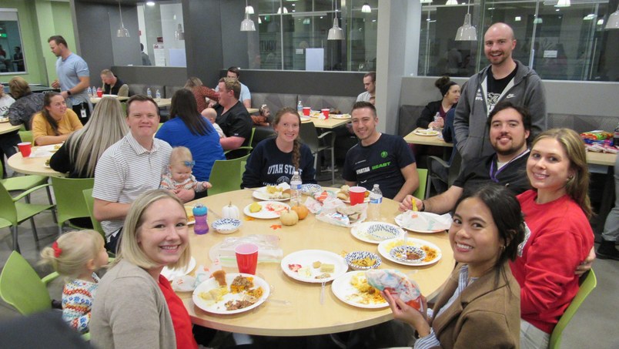
Past Activities
  Trivia Night
  Hiking
  Yard Games
  Blood drive
  Fire Lake
  Winterfest - HUGE
  Trunk-or-Treat
  Friendsgiving
  Favorite Things
  Pottery/Throwing
  Resource Night
  HPSP Night
  Town Halls
  Barre Workout
  Potlucks

Slide 23
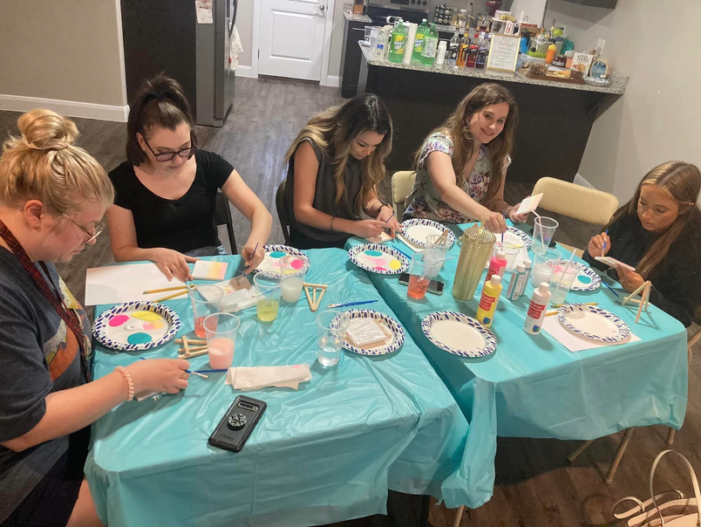
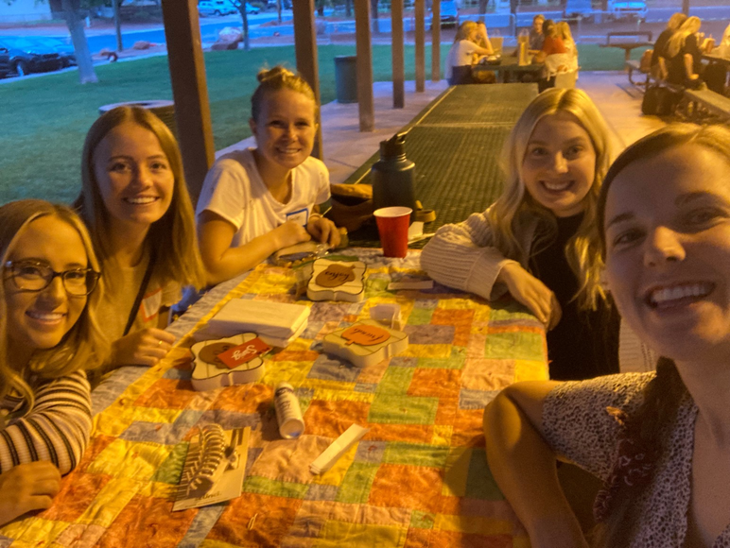
Activities Committee
  Plan monthly activities for SO's
  Great way to get involved
  Great way to get to know people and become friends with other SO's
Notes:
Helen: We plan activities most for Significant Others.
Also plan activities a few activities for whole family and date night.

Slide 24
Activities Committee
Interested in joining the activities committee?
Fill out the application here!
Notes:
Helen: We plan activities most for Significant Others.
Also plan activities a few activities for whole family and date night.

Slide 25
Social Media Coordinator
Callie King-Stevens
  Husband Parker is in his 2nd year
  Pet hedgehog named Prickles
  Design/put out content, maintain social media presence & website
  Enjoys naps, tea, reading, writing, fun TV and movies, hiking, music, and games
  Works as a content writer for a marketing agency
  Excited to get to know you guys, help create a support system & find joy in the med school journey!
Notes:
Jess introduce self

Slide 26
Our Platforms
Notes:
KathrAnn will discuss our platforms

Slide 27
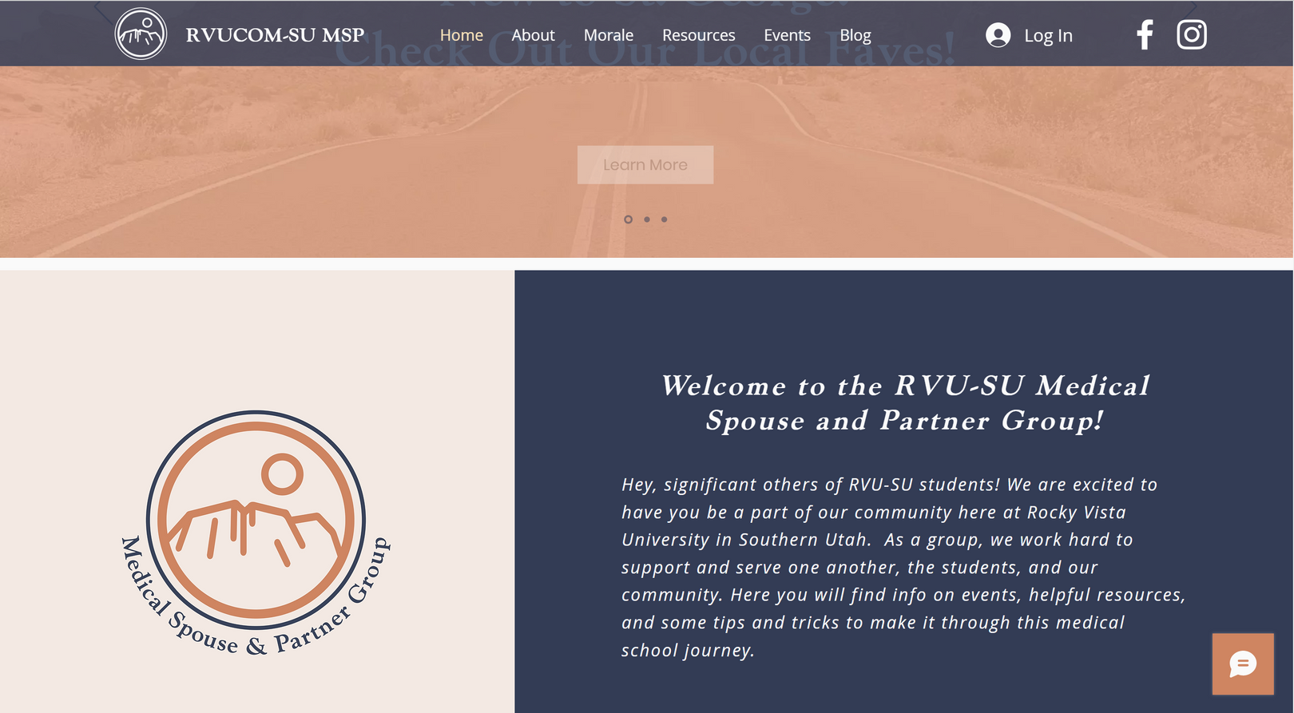
Website
www.supportingmyfuturedo.com
Notes:
KathrAnn will talk about our website. (JESS click link and follow around as I talk about it?)
WEBSITE:
- Homepage: Signing up for newsletter
- About page: Read vision and mention can find presidency here
- Moral page: Explain what this is
- Resources page: show main resource page. Explain you can find students schedules (will add MSBS) Information about government benefits and savings, things to do in southern utah, helpful books/podcast, and groups.

Slide 28
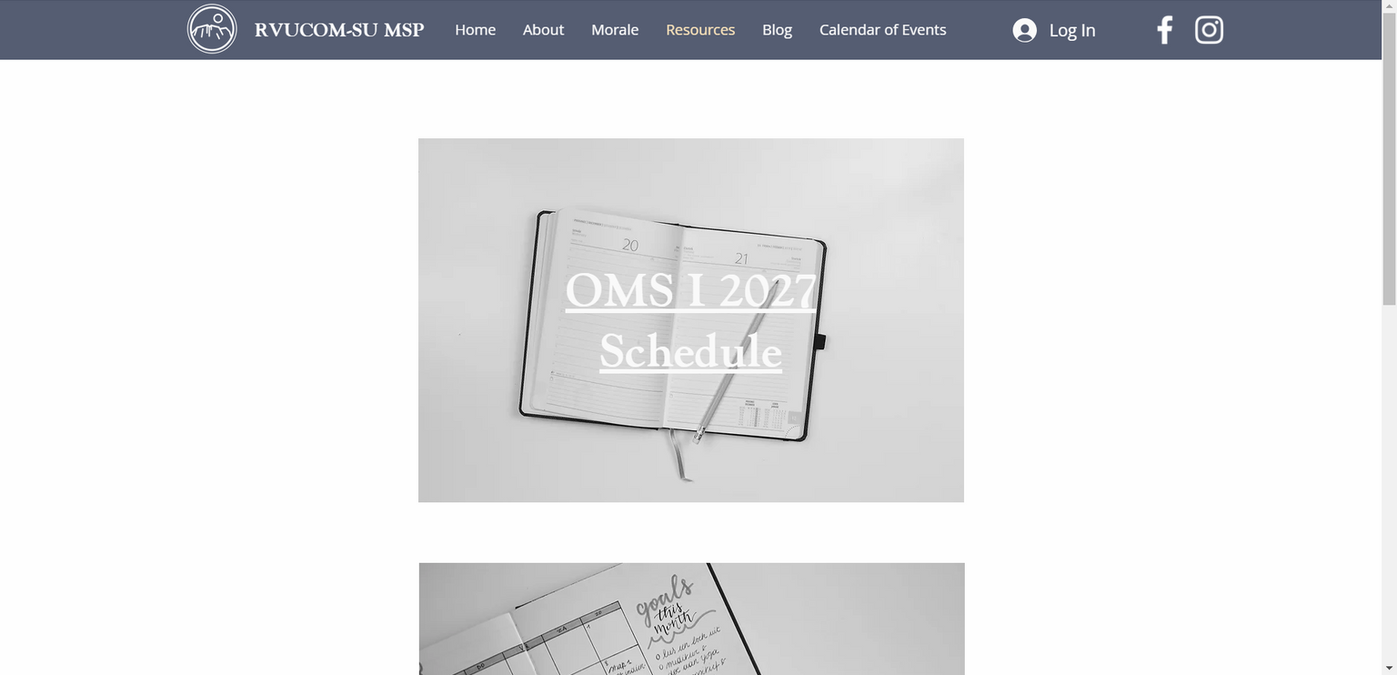
Student Schedules
https://www.supportingmyfuturedo.com/student-schedules
Notes:
KathrAnn will talk about our website. (JESS click link and follow around as I talk about it?)
WEBSITE:
- Homepage: Signing up for newsletter
- About page: Read vision and mention can find presidency here
- Moral page: Explain what this is
- Resources page: show main resource page. Explain you can find students schedules (will add MSBS) Information about government benefits and savings, things to do in southern utah, helpful books/podcast, and groups.

Slide 29
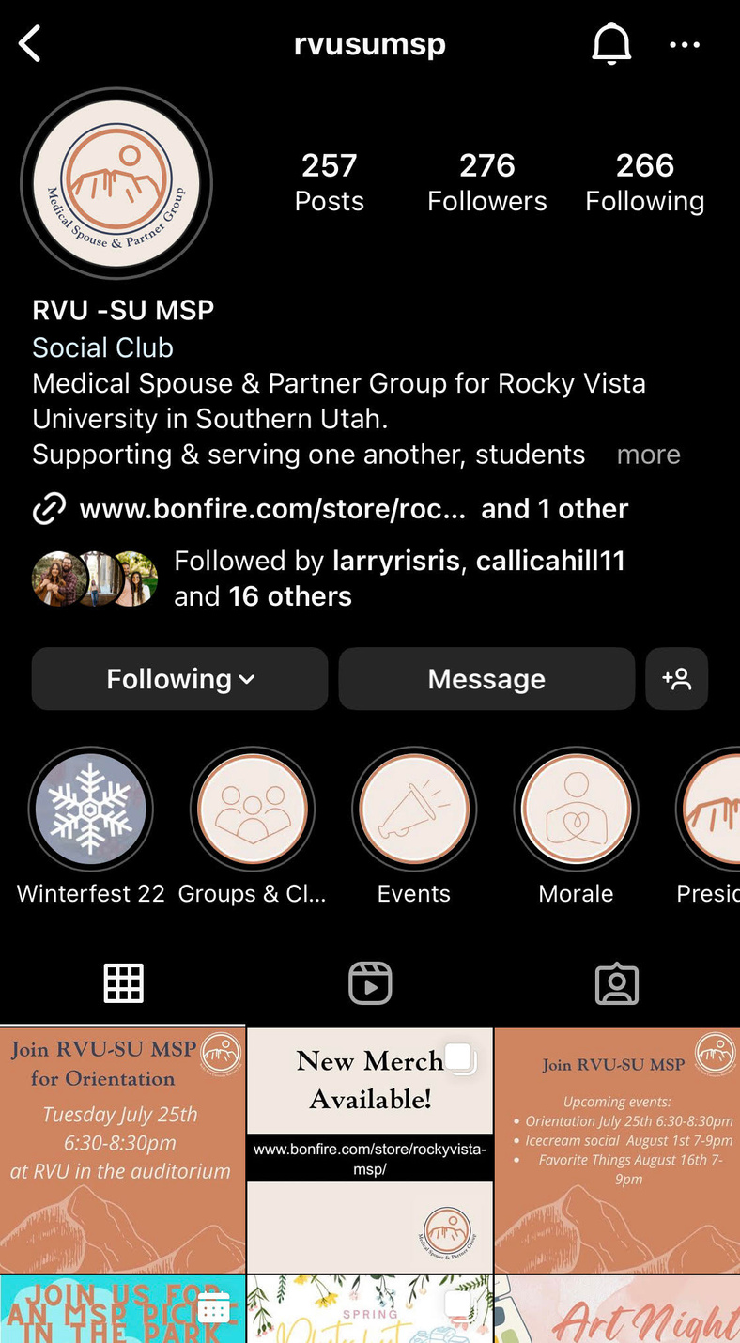
Instagram
@rvusumsp

Slide 30
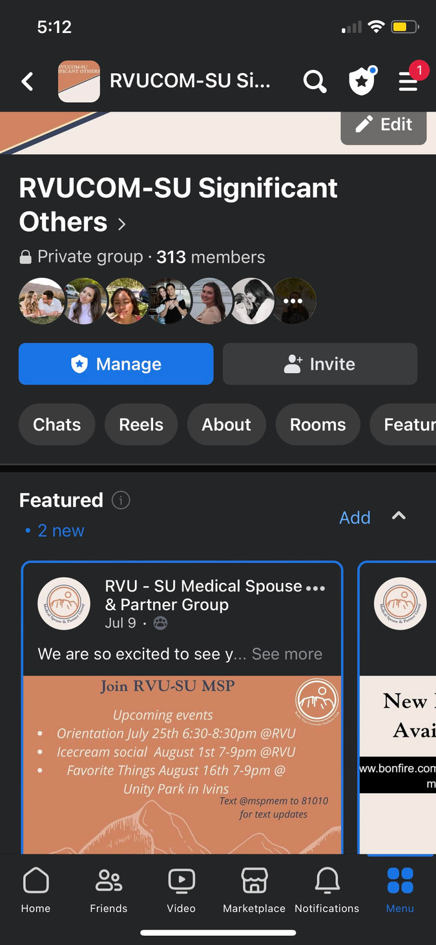
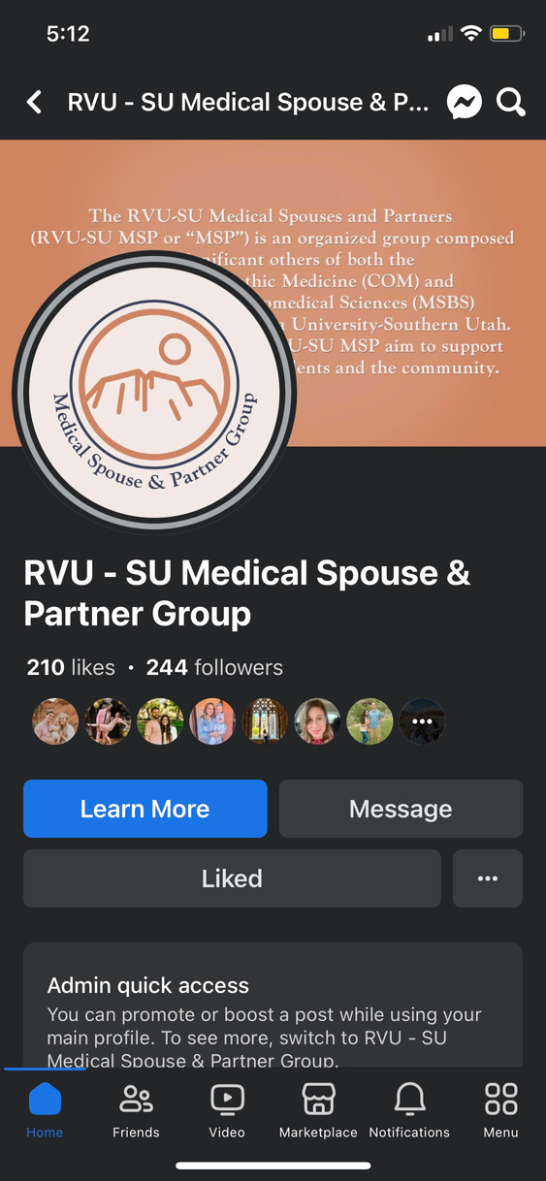
Facebook
RVUCOM-SU Significant Others Group
RVU-SU Medical Spouse & Partner Page
Notes:
explain difference between the group and page

Slide 31
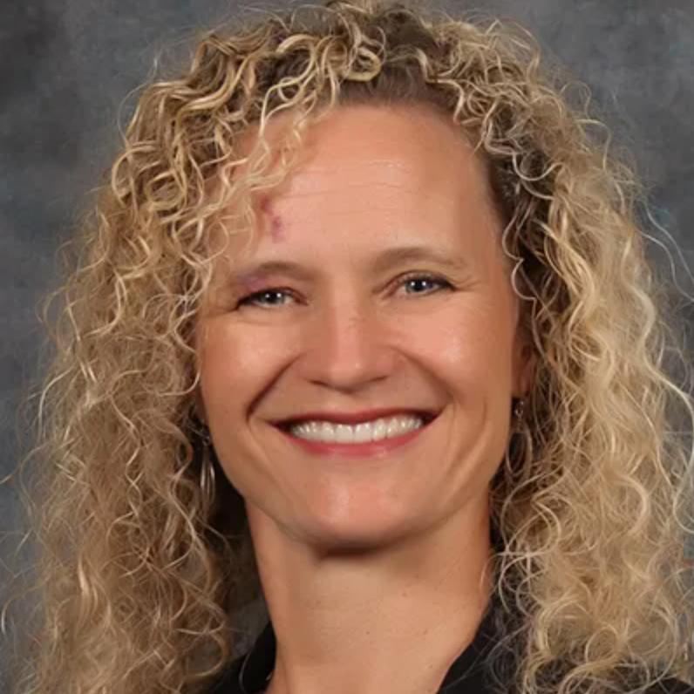

Special Guest
See other slideshow for Vie's presentation
Vie Van Noy, MS, TRT
Director of Student Life and Special Events
Notes:
Vie comes up on stage and introduces herself, then pulls up her own slide show.

Slide 32
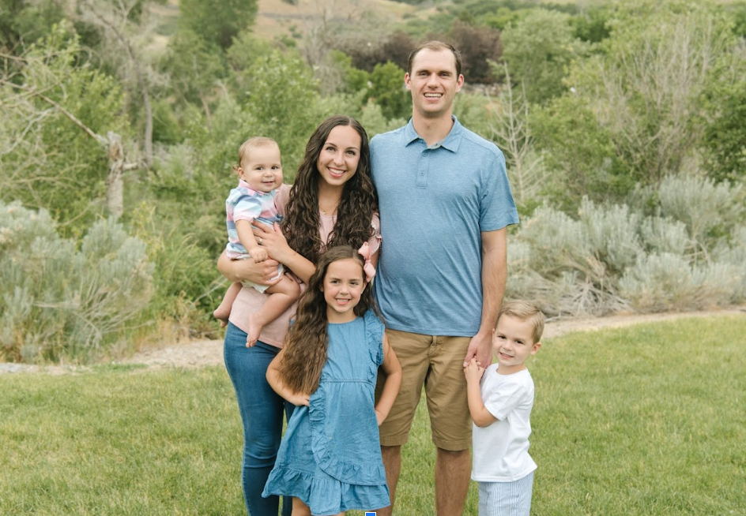
MSP 2023-2024 Keynote Speaker
Jessie Sterr
4th Year Significant Other
Notes:
KathrAnn announces our keynote
Sarah Nebeker is one of the most positive people I have ever met. Her husband is currently a 4th year and they have two adorable little girls together.

Slide 33

Let’s Get to
Know YOU!

Slide 34
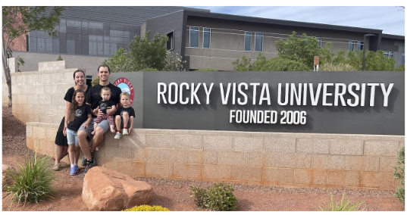
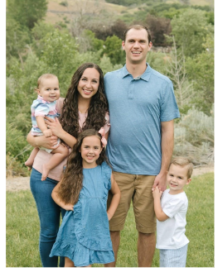
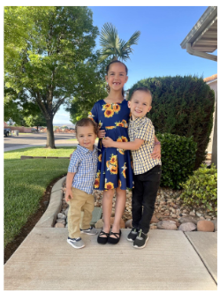
Get to know me!
Married to Wayne - OMS IV
From Cache Valley. Go Aggies!
3 kiddos:
Lydia (6.5), Xavier (4.5), Liam (2)
Love all things MSP
Advocate for having a family in Med School
Overseer of Craft Club

Slide 35
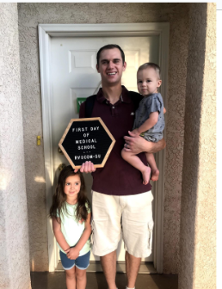
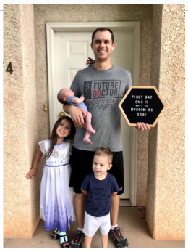
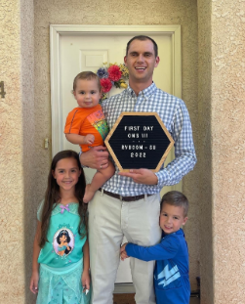
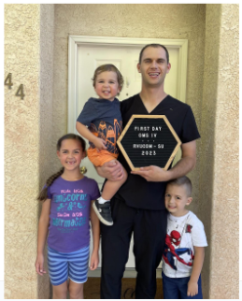
Having a family in Med School
  It’s not only possible, it’s worth it!!
  Don’t hesitate to grow your family
  I am your number one fan!!

Slide 36
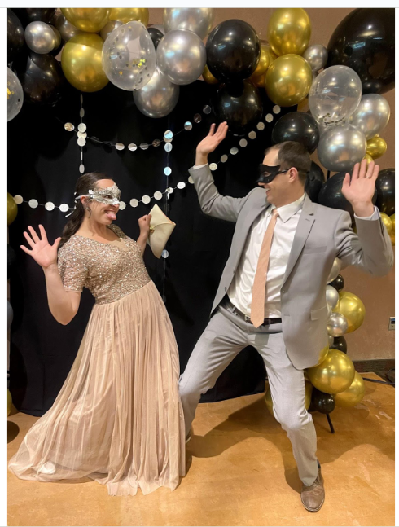
Student and SO Relationship
  You choose what you prioritize
  No unspoken expectations
  Don’t wait around
  Have a burnout plan

Slide 37
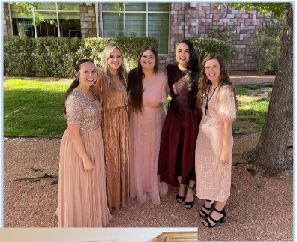
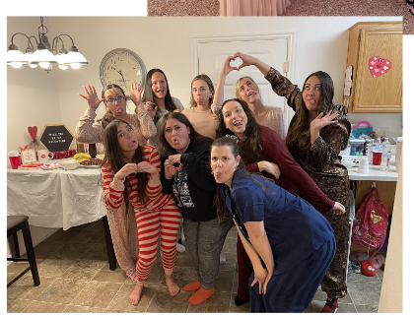
Finding
Your Tribe
  Get involved in MSP
  It may take a little time
  Friends in med school completely understand!

Slide 38
WIC - Women, Infants, and Children
  Services for pregnant women, new mothers, infants and children up to 5 yrs
  Provides: grains, produce, dairy and protein
  Appointments every 3 months
  eWIC card
  3 months at a time
  Get the app - WIC Shopper
  Works at self checkout but NOT grocery pickup

Slide 39
EBT / SNAP / Food Stamps
  Gov. funds for nonprepared food and drink
  Funds added monthly based on family size
  Roll over so long as you use your card every 10 months
  Income under $2,000 / month, Assets under $2,500
  Fun buys: Salad Bar, Harmon’s Gelato, and Maverick
  Works at self checkout AND grocery pickup
  Other fun benefits!!

Slide 40
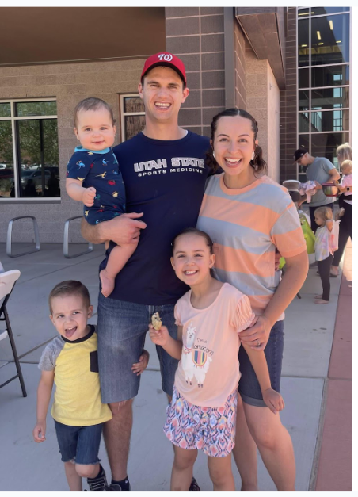
My Last 2 Cents
  “Expect the Worst, hope for the Best!”
  Everyone’s experience is different
  Please reach out!!
    FB: Wayne-Jessie Sterr
    Instagram: jessie.sterr22
  You Got this!!

Slide 41
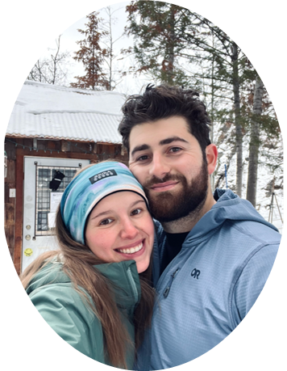
MSP 2023-2024 Keynote Student Speaker
Nicole Blekhter
2nd Year OMS Student
Notes:
KathrAnn announces our keynote
Sarah Nebeker is one of the most positive people I have ever met. Her husband is currently a 4th year and they have two adorable little girls together.

Slide 42
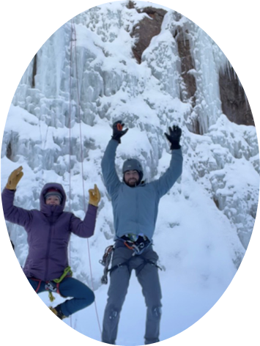
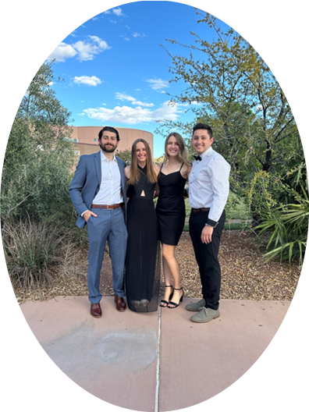
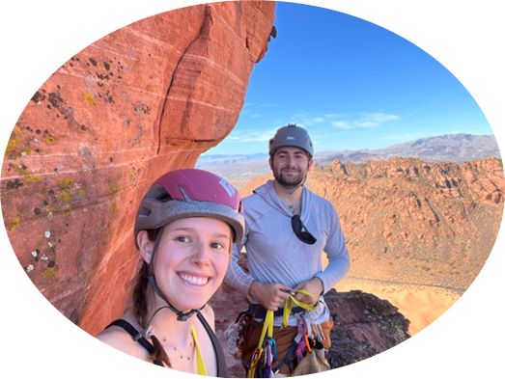
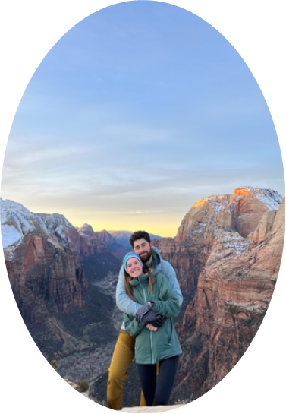

SUPPORTING YOUR LOVED ONE THROUGH MEDICAL SCHOOL & BEYOND
  You are going through this TOGETHER
  Finding a balance: make time for the little things
  Vocalize what you need
  Check-ins
  Carve out time to do the things you love doing together

Slide 43
New & Returning
Significant Others Survey
Please fill out the survey here
Notes:
Mariana: While we set up our panelists you're welcome to take the time to chat with those around you. We also have a form, both up here on the screen and the paper one infront of you. Please take the time to fill this out so we can get to know you all better.

Slide 44
Thank You for Coming!
Notes:
KathrAnn will end the Q&A if no more Q's or around 8:30pm.
Thanking panelists, Vie and keynote.
Reminding members about upcoming events, to turn in papers at door to (Heidi?), and meet in the lobby for snacks and to buy some merch if they want.

